Slide 1

Unsupervised learning

Slide 2
Introduction
The data have no target attribute
We want to explore the data to find some patterns in them
given unlabeled data and allow discover patterns and insights on their own
without explicit direction or instruction

Slide 3
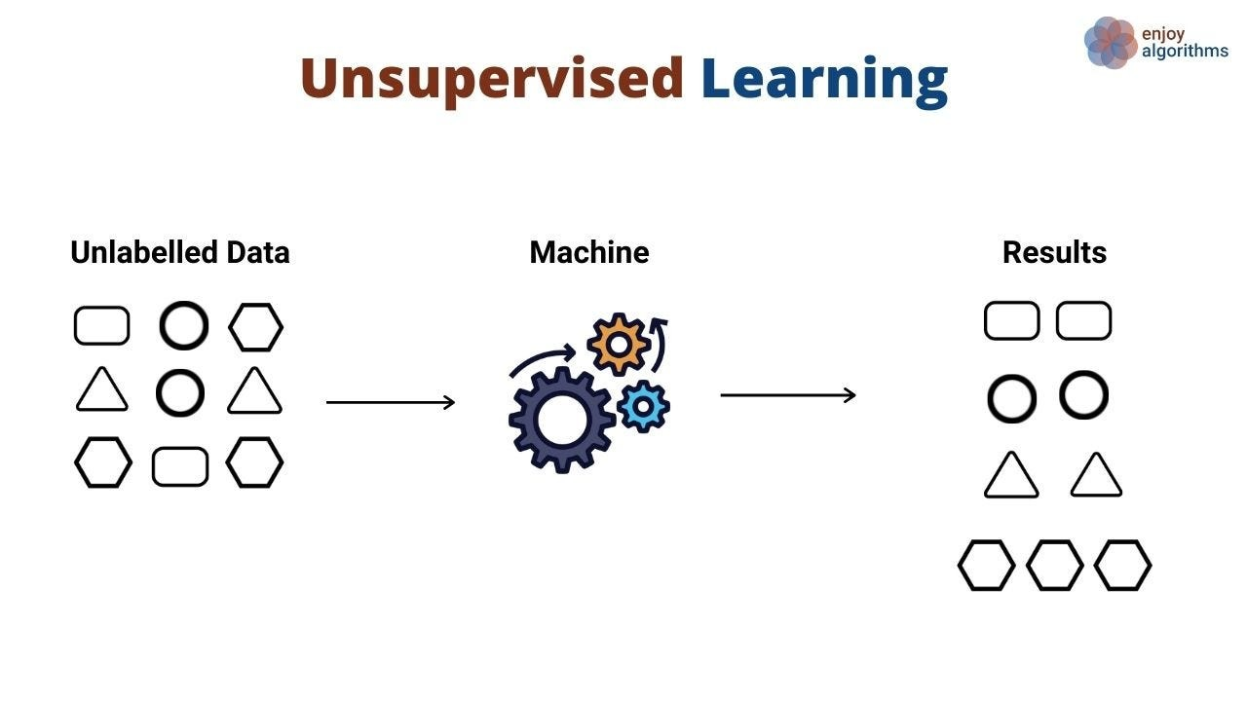

Slide 4
Unsupervised Learning Algorithms
Three types:
Clustering
Association Rule Learning
Dimensionality Reduction

Slide 5
Clustering
Clustering in unsupervised machine learning algorithm
process of grouping unlabeled data into clusters based on their similarities
identify patterns and relationships in the data without any prior knowledge of the data’s meaning
Some clustering algorithms are : K-means Clustering, Hierarchical Clustering, Mean-Shift Clustering, Spectral Clustering etc.

Slide 6
K-Means Clustering
groups the unlabeled dataset into different clusters
K defines the number of pre-defined clusters
It is a centroid-based algorithm, where each cluster is associated with a centroid.
The main aim of this algorithm is to minimize the sum of distances between the data point and their corresponding clusters.

Slide 7
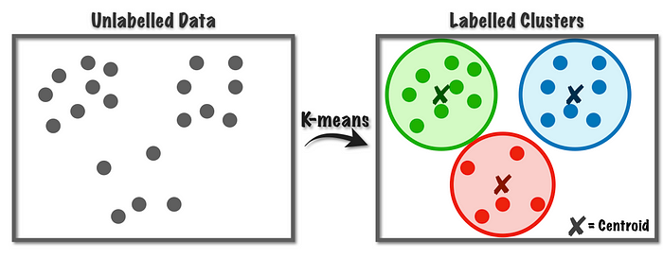

Slide 8
How does the K-Means Algorithm Work?
Step-1: Select the number K to decide the number of clusters.
Step-2: Select random K points or centroids. (It can be other from the input dataset).
Step-3: Assign each data point to their closest centroid, which will form the predefined K clusters.
Step-4: Calculate the variance and place a new centroid of each cluster.
Step-5: Repeat the third steps, which means reassign each datapoint to the new closest centroid of each cluster.
Step-6: If any reassignment occurs, then go to step-4 else go to FINISH.
Step-7: The model is ready.

Slide 11

Implementation
In jupyter notebook

Slide 12
How to choose the best value of "K "?
In jupyter notebook

Slide 13
Disadvantages of k-means
Choosing K manually
Clustering outliers
Centroids can be dragged by outliers, or outliers might get their own cluster instead of being ignored. Consider removing or clipping outliers before clustering.
Scaling with number of dimensions.

Slide 14

Thank You

